Slide 1
Chapter 8: Statistical Inference: Significance Tests About Hypotheses
Section 8.1: What Are the Steps for Performing a Significance Test?

Slide 2
Learning Objectives
5 Steps of a Significance Test
Assumptions
Hypotheses
Calculate the test statistic
P-Value
Conclusion and Statistic Significance

Slide 3
Learning Objective 1: Significance Test
A significance test is a method of using data to summarize the evidence about a hypothesis
A significance test about a hypothesis has five steps
Assumptions
Hypotheses
Test Statistic
P-value
Conclusion

Slide 4
Learning Objective 2: Step 1: Assumptions
A (significance) test assumes that the data production used randomization
Other assumptions may include:
Assumptions about the sample size
Assumptions about the shape of the population distribution

Slide 5
Learning Objective 3: Step 2: Hypothesis
A hypothesis is a statement about a population, usually of the form that a certain parameter takes a particular numerical value or falls in a certain range of values
The main goal in many research studies is to check whether the data support certain hypotheses

Slide 6
Learning Objective 3: Step 2: Hypotheses
Each significance test has two hypotheses:
The null hypothesis is a statement that the parameter takes a particular value. It has a single parameter value.
The alternative hypothesis states that the parameter falls in some alternative range of values.

Slide 7
Learning Objective 3: Null and Alternative Hypotheses
The value in the null hypothesis usually represents no effect
The symbol H_{o} denotes null hypothesis
The value in the alternative hypothesis usually represents an effect of some type
The symbol H_{a} denotes alternative hypothesis
The alternative hypothesis should express what the researcher hopes to show.
The hypotheses should be formulated before viewing or analyzing the data!

Slide 8
Learning Objective 4: Step 3: Test Statistic
A test statistic describes how far the point estimate falls from the parameter value given in the null hypothesis (usually in terms of the number of standard errors between the two).
If the test statistic falls far from the value suggested by the null hypothesis in the direction specified by the alternative hypothesis, it is good evidence against the null hypothesis and in favor of the alternative hypothesis.
We use the test statistic to assesses the evidence against the null hypothesis by giving a probability , the P-Value.

Slide 9
Learning Objective 5: Step 4: P-value
To interpret a test statistic value, we use a probability summary of the evidence against the null hypothesis, H_{o}
First, we presume that H_{o} is true
Next, we consider the sampling distribution from which the test statistic comes
We summarize how far out in the tail of this sampling distribution the test statistic falls

Slide 10
Learning Objective 5: Step 4: P-value
We summarize how far out in the tail the test statistic falls by the tail probability of that value and values even more extreme
This probability is called a P-value
The smaller the P-value, the stronger the evidence is against H_{o}

Slide 11
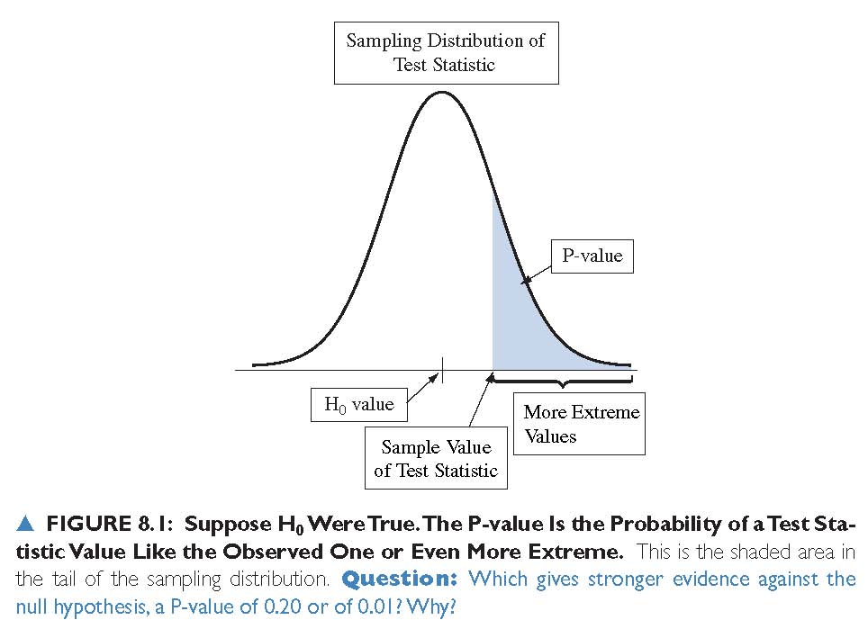
Learning Objective 5: Step 4: P-value

Slide 12
Learning Objective 5: Step 4: P-value
The P-value is the probability that the test statistic equals the observed value or a value even more extreme
It is calculated by presuming that the null hypothesis H is true
The smaller the P-value, the stronger the evidence the data provide against the null hypothesis. That is, a small P-value indicates a small likelihood of observing the sampled results if the null hypothesis were true.

Slide 13
Learning Objective 6: Step 5: Conclusion
The conclusion of a significance test reports the P-value and interprets what it says about the question that motivated the test

Slide 14
Chapter 8: Statistical Inference: Significance Tests About Hypotheses
Section 8.2: Significance Tests About Proportions

Slide 15
Learning Objectives:
Steps of a Significance Test about a Population Proportion
Example: One-Sided Hypothesis Test
How Do We Interpret the P-value?
Two-Sided Hypothesis Test for a Population Proportion
Summary of P-values for Different Alternative Hypotheses
Significance Level
One-Sided vs Two-Sided Tests
The Binomial Test for Small Samples

Slide 16
Learning Objective 1: Example: Are Astrologers’ Predictions Better Than Guessing?
An astrologer prepares horoscopes for 116 adult volunteers. Each subject also filled out a California Personality Index (CPI) survey. For a given adult, his or her horoscope is shown to the astrologer along with their CPI survey as well as the CPI surveys for two other randomly selected adults. The astrologer is asked which survey is the correct one for that adult
With random guessing, p = 1/3
The astrologers’ claim: p > 1/3
The hypotheses for this test:
H_{o}: p = 1/3
H_{a}: p > 1/3

Slide 17
Learning Objective 1: Steps of a Significance Test about a Population Proportion
Step 1: Assumptions
The variable is categorical
The data are obtained using randomization
The sample size is sufficiently large that the sampling distribution of the sample proportion is approximately normal:
np ≥ 15 and n(1-p) ≥ 15

Slide 18
Learning Objective 1: Steps of a Significance Test about a Population Proportion
Step 2: Hypotheses
The null hypothesis has the form:
H₀: p = p₀
The alternative hypothesis has the form:
H_{a}: p > p₀ (one-sided test) or
H_{a}: p < p₀ (one-sided test) or
H_{a}: p ≠ p₀ (two-sided test)

Slide 19
Learning Objective 1: Steps of a Significance Test about a Population Proportion
Step 3: Test Statistic
The test statistic measures how far the sample proportion falls from the null hypothesis value, p₀, relative to what we’d expect if H₀ were true
The test statistic is:

Slide 20
Learning Objective 1: Steps of a Significance Test about a Population Proportion
Step 4: P-value
The P-value summarizes the evidence
It describes how unusual the observed data would be if H₀ were true

Slide 21
Learning Objective 1: Steps of a Significance Test about a Population Proportion
Step 5: Conclusion
We summarize the test by reporting and interpreting the P-value

Slide 22
Learning Objective 2: Example 1
Step 1: Assumptions
The data is categorical – each prediction falls in the category “correct” or “incorrect”
Each subject was identified by a random number. Subjects were randomly selected for each experiment.
np=116(1/3) > 15
n(1-p) = 116(2/3) > 15

Slide 23
Learning Objective 2: Example 1
Step 2: Hypotheses
H_{0:} p = 1/3
H_{a:} p > 1/3

Slide 24
Learning Objective 2: Example 1
Step 3: Test Statistic:
In the actual experiment, the astrologers were correct with 40 of their 116 predictions (a success rate of 0.345)

Slide 25
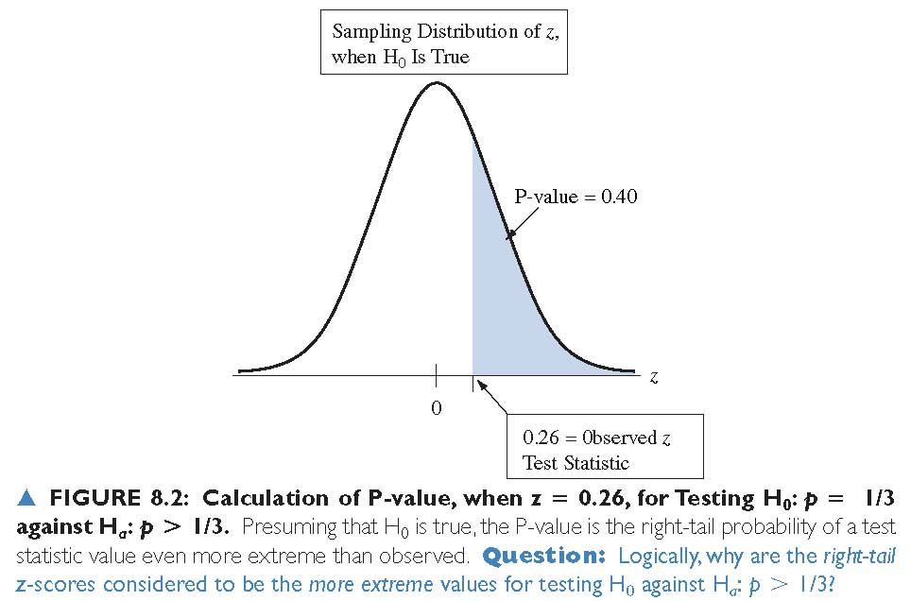
Learning Objective 2: Example 1
Step 4: P-value
The P-value is 0.40

Slide 26
Learning Objective 2: Example 1
Step 5: Conclusion
The P-value of 0.40 is not especially small
It does not provide strong evidence against H_{0:} p = 1/3
There is not strong evidence that astrologers have special predictive powers

Slide 27
Learning Objective 3: How Do We Interpret the P-value?
A significance test analyzes the strength of the evidence against the null hypothesis
We start by presuming that H₀ is true
The burden of proof is on H_{a}

Slide 28
Learning Objective 3: How Do We Interpret the P-value?
The approach used in hypothesis testing is called a proof by contradiction
To convince ourselves that H_{a} is true, we must show that data contradict H₀
If the P-value is small, the data contradict H₀ and support H_{a}

Slide 29
Learning Objective 4: Two-Sided Significance Tests
A two-sided alternative hypothesis has the form H_{a}: p ≠ p₀
The P-value is the two-tail probability under the standard normal curve
We calculate this by finding the tail probability in a single tail and then doubling it

Slide 30
Learning Objective 4: Example 2
Study: investigate whether dogs can be trained to distinguish a patient with bladder cancer by smelling compounds released in the patient’s urine

Slide 31
Learning Objective 4: Example 2
Experiment:
Each of 6 dogs was tested with 9 trials
In each trial, one urine sample from a bladder cancer patient was randomly place among 6 control urine samples

Slide 32
Learning Objective 4: Example 2
Results:
In a total of 54 trials with the six dogs, the dogs made the correct selection 22 times (a success rate of 0.407)

Slide 33
Learning Objective 4: Example 2
Does this study provide strong evidence that the dogs’ predictions were better or worse than with random guessing?

Slide 34
Learning Objective 4: Example 2
Step 1: Check the sample size requirement:
Is the sample size sufficiently large to use the hypothesis test for a population proportion?
Is np₀ >15 and n(1-p₀) >15?
54(1/7) = 7.7 and 54(6/7) = 46.3
The first, np₀ is not large enough
We will see that the two-sided test is robust when this assumption is not satisfied

Slide 35
Learning Objective 4: Example 2
Step 2: Hypotheses
H_{0:} p = 1/7
H_{a:} p ≠ 1/7

Slide 36
Learning Objective 4: Example 2
Step 3: Test Statistic

Slide 37
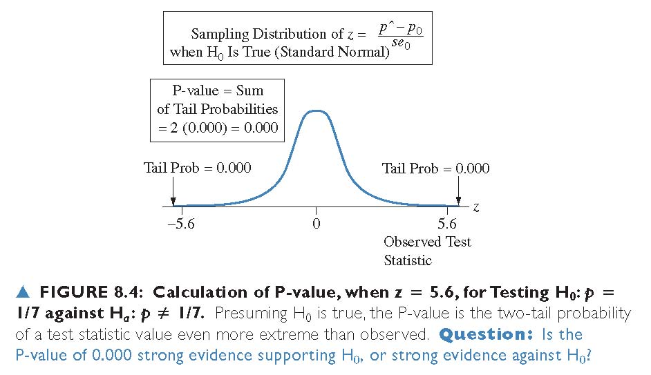
Learning Objective 4: Example 2
Step 4: P-value

Slide 38
Learning Objective 4: Example 2
Step 5: Conclusion
Since the P-value is very small and the sample proportion is greater than 1/7, the evidence strongly suggests that the dogs’ selections are better than random guessing

Slide 39
Learning Objective 4: Example 2
Insight:
In this study, the subjects were a convenience sample rather than a random sample from some population
Also, the dogs were not randomly selected
Any inferential predictions are highly tentative. They are valid only to the extent that the patients and the dogs are representative of their populations
The predictions become more conclusive if similar results occur in other studies

Slide 40
Learning Objective 4: Example 2

Slide 41
Learning Objective 5: Summary of P-values for Different Alternative Hypotheses
Alternative Hypothesis | P-value
H_{a}: p > p₀ | Right-tail probability
H_{a}: p < p₀ | Left-tail probability
H_{a}: p ≠ p₀ | Two-tail probability

Slide 42
Learning Objective 6: The Significance Level Tells Us How Strong the Evidence Must Be
Sometimes we need to make a decision about whether the data provide sufficient evidence to reject H₀
Before seeing the data, we decide how small the P-value would need to be to reject H₀
This cutoff point is called the significance level

Slide 43
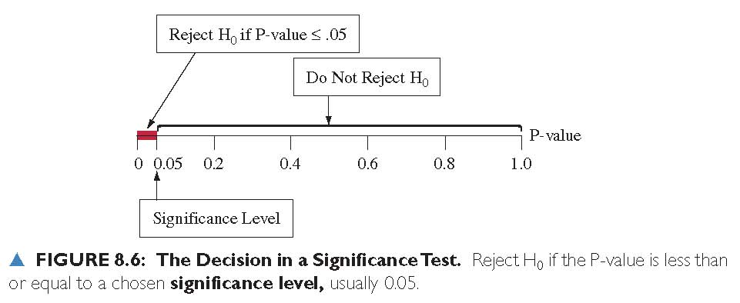
Learning Objective 6: The Significance Level Tells Us How Strong the Evidence Must Be

Slide 44
Learning Objective 6: Significance Level
The significance level is a number such that we reject H₀ if the P-value is less than or equal to that number
In practice, the most common significance level is 0.05
When we reject H₀ we say the results are statistically significant

Slide 45
Learning Objective 6: Possible Decisions in a Hypothesis Test
P-value: | Decision about H₀:
≤ α | Reject H₀
> α | Fail to reject H₀

Slide 46
Learning Objective 6: Report the P-value
Learning the actual P-value is more informative than learning only whether the test is “statistically significant at the 0.05 level”
The P-values of 0.01 and 0.049 are both statistically significant in this sense, but the first P-value provides much stronger evidence against H₀ than the second

Slide 47
Learning Objective 6: “Do Not Reject H₀” Is Not the Same as Saying “Accept H₀”
Analogy: Legal trial
Null Hypothesis: Defendant is Innocent
Alternative Hypothesis: Defendant is Guilty
If the jury acquits the defendant, this does not mean that it accepts the defendant’s claim of innocence
Innocence is plausible, because guilt has not been established beyond a reasonable doubt

Slide 48
Learning Objective 7: One-Sided vs Two-Sided Tests
Things to consider in deciding on the alternative hypothesis:
The context of the real problem
In most research articles, significance tests use two-sided P-values
Confidence intervals are two-sided

Slide 49
Learning Objective 8: The Binomial Test for Small Samples
The test about a proportion assumes normal sampling distributions for and the z-test statistic.
It is a large-sample test because the CLT requires that the expected numbers of successes and failures be at least 15. In practice, the large-sample z test still performs quite well in two-sided alternatives even for small samples.
Warning: For one-sided tests, when p₀ differs from 0.50, the large-sample test does not work well for small samples

Slide 50
Learning Objective 9: Class Exercise 1
In a survey by Media General and the Associated Press, 813 of the 1084 respondents indicated support for a ban on household aerosols. At the 1% significance level, test the claim that more than 70% of the population supports the ban.

Slide 51
Learning Objective 9: Class Exercise 2
In a Roper Organization poll of 2000 adults, 1280 have money in regular savings accounts. Use this sample data to test the claim that less than 65% of all adults have money in regular savings accounts. Use a 5% level of significance.

Slide 52
Learning Objective 9: Class Exercise 3
According to a Harris Poll, 71% of Americans believe that the overall cost of lawsuits is too high. If a random sample of 500 people results in 74% who hold that belief, test the claim that the actual percentage is 71%. Use a 10% significance level.

