Slide 1
Chapter 8: Statistical Inference: Significance Tests about Hypotheses
Section 8.3: Significance Tests About Means

Slide 2
Learning Objectives
Steps of a Significance Test about a Population Mean
Summary of P-values for Different Alternative Hypotheses
Example: Significance Test for a Population Mean
Results of Two-Sided Tests and Results of Confidence Intervals Agree
What If the Population Does Not Satisfy the Normality Assumption?
Regardless of Robustness, Look at the Data

Slide 3
Learning Objective 1: Steps of a Significance Test About a Population Mean
Step 1: Assumptions
The variable is quantitative
The data are obtained using randomization
The population distribution is approximately normal. This is most crucial when n is small and H_{a} is one-sided.

Slide 4
Learning Objective 1: Steps of a Significance Test About a Population Mean
Step 2: Hypotheses:
The null hypothesis has the form:
H₀: µ = µ₀
The alternative hypothesis has the form:
H_{a}: µ > µ₀ (one-sided test) or
H_{a}: µ < µ₀ (one-sided test) or
H_{a}: µ ≠ µ₀ (two-sided test)

Slide 5
Learning Objective 1: Steps of a Significance Test About a Population Mean
Step 3: Test Statistic
The test statistic measures how far the sample mean falls from the null hypothesis value µ₀, as measured by the number of standard errors between them
The test statistic is:

Slide 6
Learning Objective 1: Steps of a Significance Test About a Population Mean
Step 4: P-value
The P-value summarizes the evidence
It describes how unusual the data would be if H₀ were true

Slide 7
Learning Objective 1: Steps of a Significance Test About a Population Mean
Step 5: Conclusion
We summarize the test by reporting and interpreting the P-value

Slide 8
Learning Objective 2: Summary of P-values for Different Alternative Hypotheses
Alternative Hypothesis | P-value
H_{a}: µ > µ₀ | Right-tail probability from t distribution
H_{a}: µ < µ₀ | Left-tail probability from t distribution
H_{a}: µ ≠ µ₀ | Two-tail probability from t distribution

Slide 9
Learning Objective 3: Example: Mean Weight Change in Anorexic Girls
A study compared different psychological therapies for teenage girls suffering from anorexia
The variable of interest was each girl’s weight change: ‘weight at the end of the study’ – ‘weight at the beginning of the study’

Slide 10
Learning Objective 3: Example: Mean Weight Change in Anorexic Girls
One of the therapies was cognitive therapy
In this study, 29 girls received the therapeutic treatment
The weight changes for the 29 girls had a sample mean of 3.00 pounds and standard deviation of 7.32 pounds

Slide 11
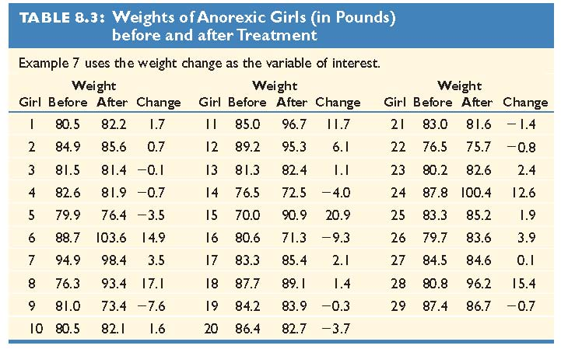
Learning Objective 3: Example: Mean Weight Change in Anorexic Girls

Slide 12
Learning Objective 3: Example: Mean Weight Change in Anorexic Girls
How can we frame this investigation in the context of a significance test that can detect whether the therapy was effective?
Null hypothesis: “no effect”
Alternative hypothesis: therapy is “effective”

Slide 13
Learning Objective 3: Example: Mean Weight Change in Anorexic Girls
Step 1: Assumptions
The variable (weight change) is quantitative
The subjects were a convenience sample, rather than a random sample. The question is whether these girls are a good representation of all girls with anorexia.
The population distribution is approximately normal

Slide 14
Learning Objective 3: Example: Mean Weight Change in Anorexic Girls
Step 2: Hypotheses
H_{0:} µ = 0
H_{a:} µ > 0

Slide 15
Learning Objective 3: Example: Mean Weight Change in Anorexic Girls
Step 3: Test Statistic

Slide 16
Learning Objective 3: Example: Mean Weight Change in Anorexic Girls
Step 4: P-value
The P-value is the area to the right of t=2.21 for the t sampling distribution with 28 df. This values is 0.018.
If the treatment had no effect, the probability of obtaining a sample this extreme would be 0.018

Slide 17
Learning Objective 3: Example: Mean Weight Change in Anorexic Girls
Step 5: Conclusion
The small P-value of 0.018 provides considerable evidence against the null hypothesis (the hypothesis that the therapy had no effect)

Slide 18
Learning Objective 3: Example: Mean Weight Change in Anorexic Girls
“The diet had a statistically significant positive effect on weight (mean change = 3 pounds, n = 29, t = 2.21, P-value = 0.018)”
The effect, however, may be small in practical terms
95% CI for µ: (0.2, 5.8) pounds

Slide 19
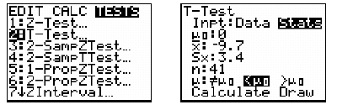
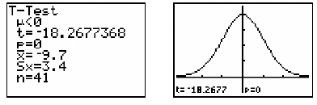
Learning Objective 3: Example: Does Low Carb Diet Work?
After 16 weeks on a diet, 41 subjects lost an average of 9.7 kg with a standard deviation of 3.4 kg
Calculate the P-value for testing: Ho: μ=0 Ha: μ<0

Slide 20
Learning Objective 4: Results of Two-Sided Tests and Results of Confidence Intervals Agree
Conclusions about means using two-sided significance tests are consistent with conclusions using confidence intervals
If P-value ≤ 0.05 in a two-sided test, a 95% confidence interval does not contain the value specified by the null hypothesis
If P-value > 0.05 in a two-sided test, a 95% confidence interval does contain the value specified by the null hypothesis

Slide 21
Learning Objective 5: What If the Population Does Not Satisfy the Normality Assumption?
For large samples (roughly about 30 or more) this assumption is usually not important
The sampling distribution of is approximately normal regardless of the population distribution

Slide 22
Learning Objective 5: What If the Population Does Not Satisfy the Normality Assumption?
In the case of small samples, we cannot assume that the sampling distribution of is approximately normal
Two-sided inferences using the t distribution are robust against violations of the normal population assumption. They still usually work well if the actual population distribution is not normal
The test does not work well for a one-sided test with small n when the population distribution is highly skewed

Slide 23
Learning Objective 6: Regardless of Robustness, Look at the Data
Whether n is small or large, you should look at the data to check for severe skew or for severe outliers
In these cases, the sample mean could be a misleading measure

