Slide 1
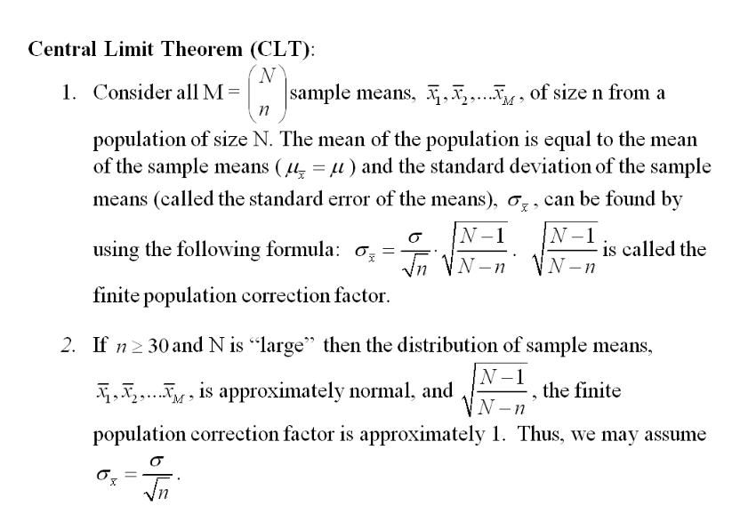
Review of Central Limit Theorem and Confidence Intervals

Slide 2
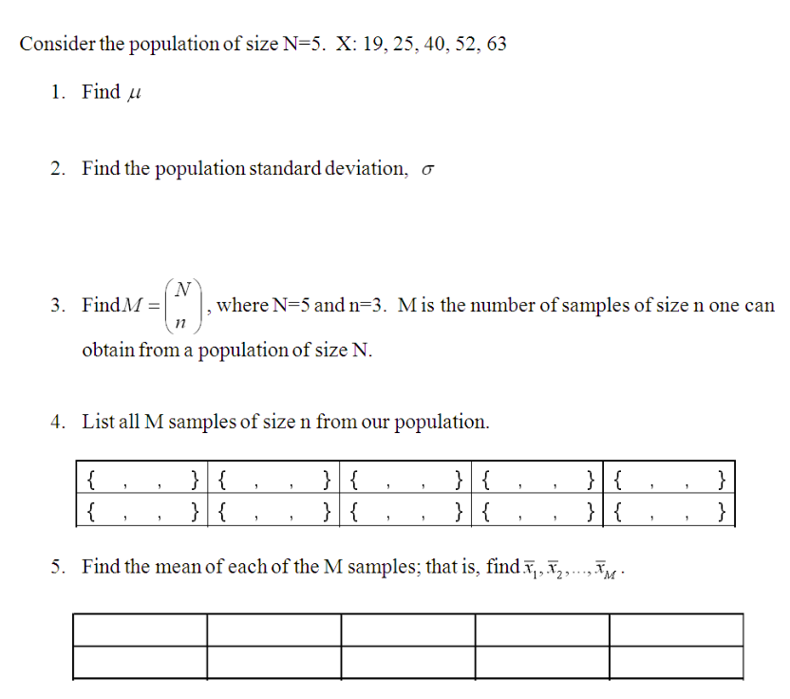

Slide 3
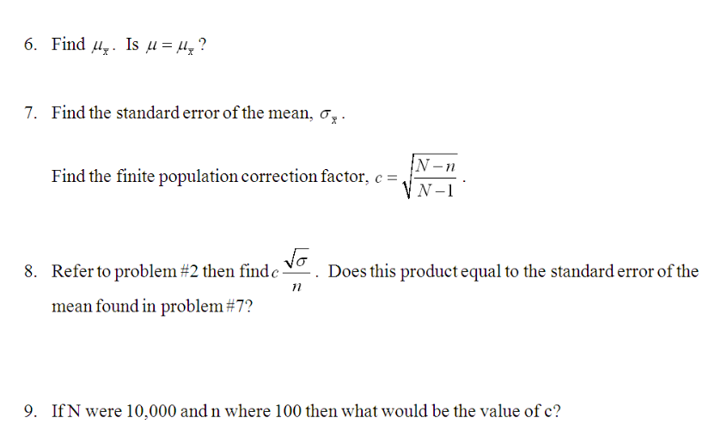

Slide 4
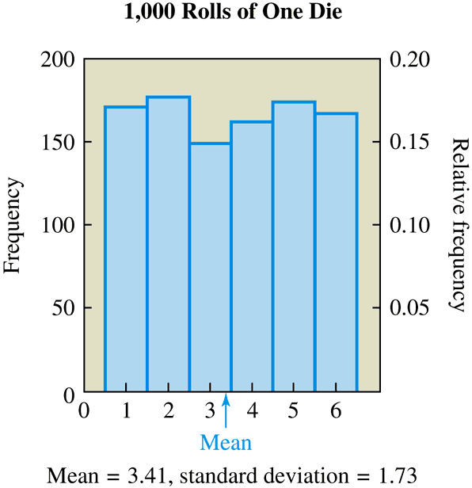
Suppose we roll one die 1,000 times and record the outcome of each roll, which can be the number 1, 2, 3, 4, 5, or 6.
Figure 1 shows a histogram of outcomes. All six outcomes have roughly the same relative frequency, because the die is equally likely to land in each of the six possible ways. That is, the histogram shows a (nearly) uniform distribution
It turns out that the distribution in Figure 1 has a mean of 3.41 and a standard deviation of 1.73.
Figure 1 Frequency and relative frequency distribution
of outcomes from rolling one die 1,000 times.
Notes:
Page 215

Slide 5
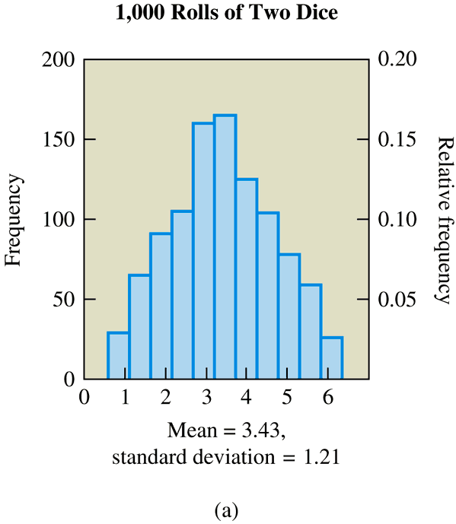
Now suppose we roll two dice 1,000 times and record the mean of the two numbers that appear on each roll. To find the mean for a single roll, we add the two numbers and divide by 2.
Figure 2 shows a typical result. The most common values in this distribution are the central values 3.0, 3.5, and 4.0. These values are common because they can occur in several ways.
The mean and standard deviation for this distribution are 3.43 and 1.21, respectively.
Figure 2 Frequency and relative frequency distribution of sample means from rolling two dice 1,000 times.
Notes:
Pages 215-216

Slide 6
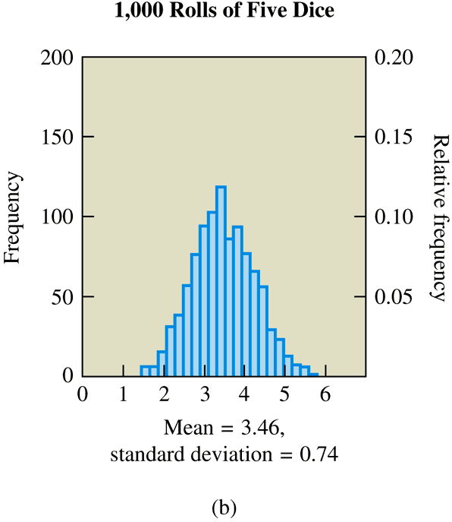
Suppose we roll five dice 1,000
times and record the mean of the five numbers on each roll. A histogram for this experiment is
shown in Figure 3.
Once again we see that the central values around 3.5 occur most frequently, but the spread of the distribution is narrower than in the two previous cases.
The mean and standard deviation are 3.46 and 0.74, respectively.
Figure 3 Frequency and relative frequency distribution of sample means from rolling five dice 1,000 times.
Notes:
Page 216

Slide 7
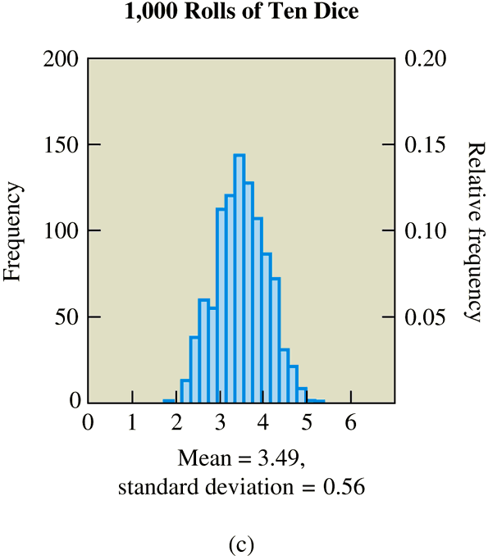
If we further increase the number of dice to ten on each of 1,000 rolls, we find the histogram in Figure 4, which is even narrower.
In this case, the mean is 3.49 and standard deviation is 0.56.
Figure 4 Frequency and relative frequency distribution of sample means from rolling ten dice 1,000 times.
Notes:
Page 216

Slide 8
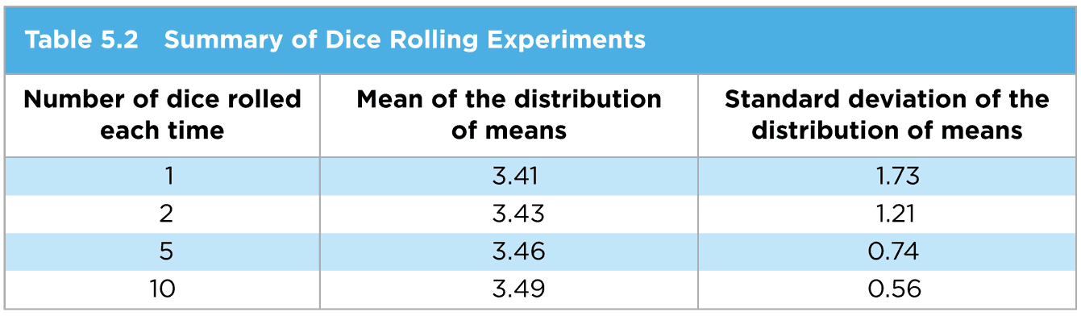
Table 5.2 shows that as the sample size increases, the mean of the distribution of means approaches the value 3.5 and the standard deviation becomes smaller (making the distribution narrower).
More important, the distribution looks more and more like a normal distribution as the sample size increases.
Notes:
Page 216

Slide 9
Confidence Intervals
A point estimate is the value of a statistic that estimates the value of a parameter.
For example, the sample mean, , is a point estimate of the population mean μ.

Slide 10
Parallel Example 1: Computing a Point Estimate
Pennies minted after 1982 are made from 97.5% zinc and 2.5% copper. The following data represent the weights (in grams) of 17 randomly selected pennies minted after 1982. Assume we know that σ=0.02 grams.
2.46 2.47 2.49 2.48 2.50 2.44 2.46 2.45 2.49
2.47 2.45 2.46 2.45 2.46 2.47 2.44 2.45
Treat the data as a simple random sample. The distribution of the weights of pennies is normal; thus, the sample size does not have to be at least 30 for the sample means to be normally distributed. Estimate the population mean weight of pennies minted after 1982.

Slide 11
The sample mean is
The point estimate of μ is 2.464 grams.

Slide 12
The shape of the distribution of all possible sample means will be normal, provided the population is normal or approximately normal, if the sample size is large (n≥30), with
  mean
  and standard deviation

Slide 13
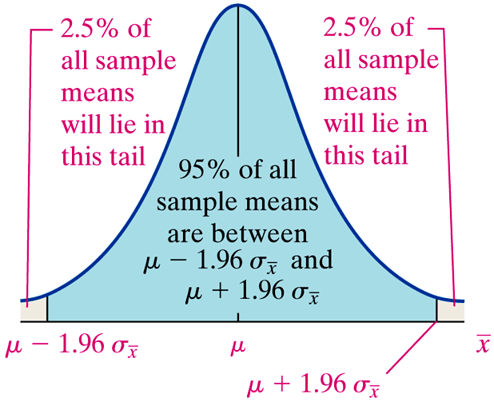
95% Confidence Interval
1.96 = invNorm(.975)
-1.96=invNorm(.025)

Slide 14
Constructing a (1- α)·100% Confidence Interval for μ, σ Known
Suppose that a simple random sample of size n is taken from a population with unknown mean, μ, and known standard deviation σ. A (1-α)·100% confidence interval for μ is given by
where is the critical Z-value.
Note: The sample size must be large (n≥30) or the population must be normally distributed.
Lower Upper
Bound: Bound:

Slide 15
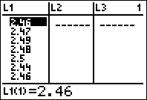

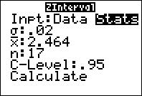
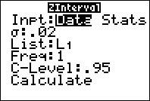
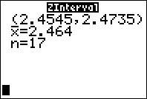
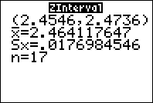

Slide 16
Confidence Intervals about a Population Mean When the Population Standard Deviation is Unknown
Comparing the Standard Normal Distribution to the t-Distribution Using Simulation
Obtain 1,000 simple random samples of size n=5 from a normal population with μ=50 and σ=10.
Determine the sample mean and sample standard deviation for each of the samples.
Compute and for each sample.
Draw a histogram for both z and t.

Slide 17
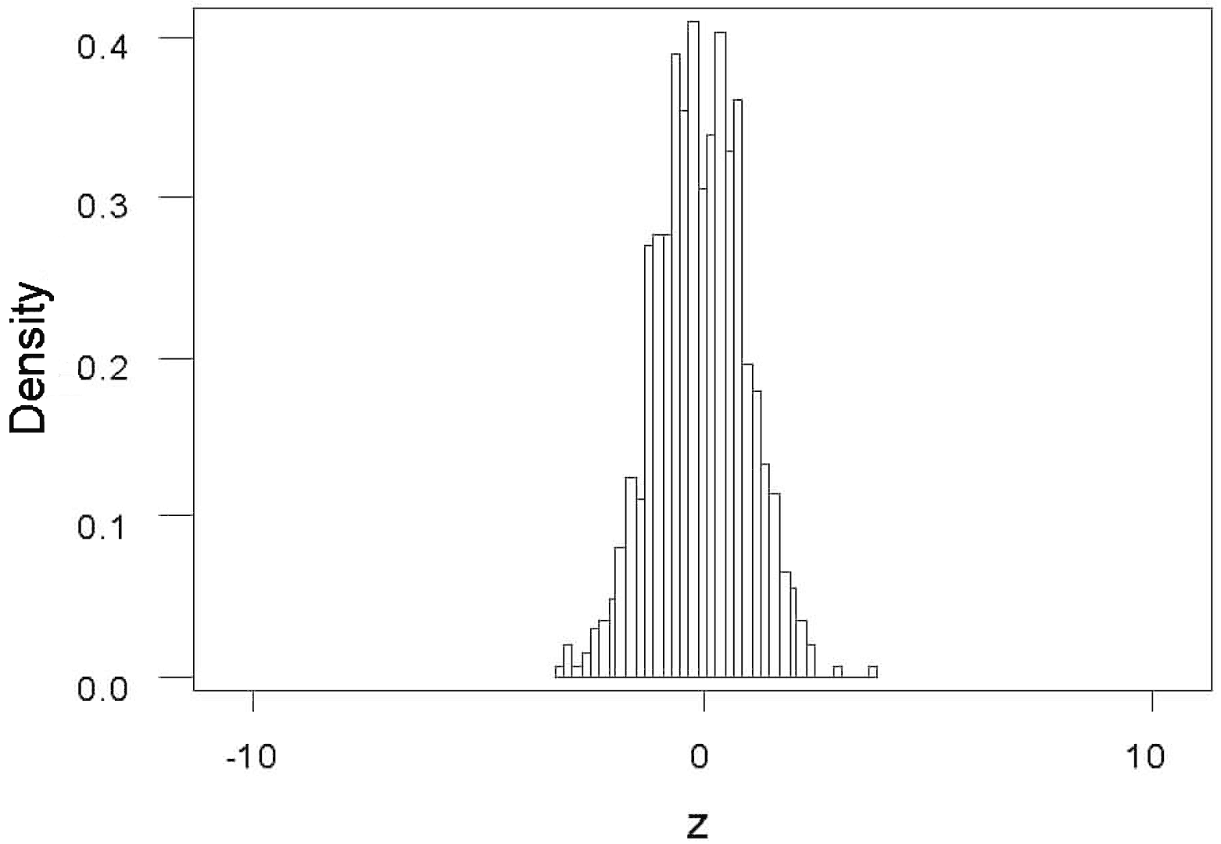
Histogram for z

Slide 18
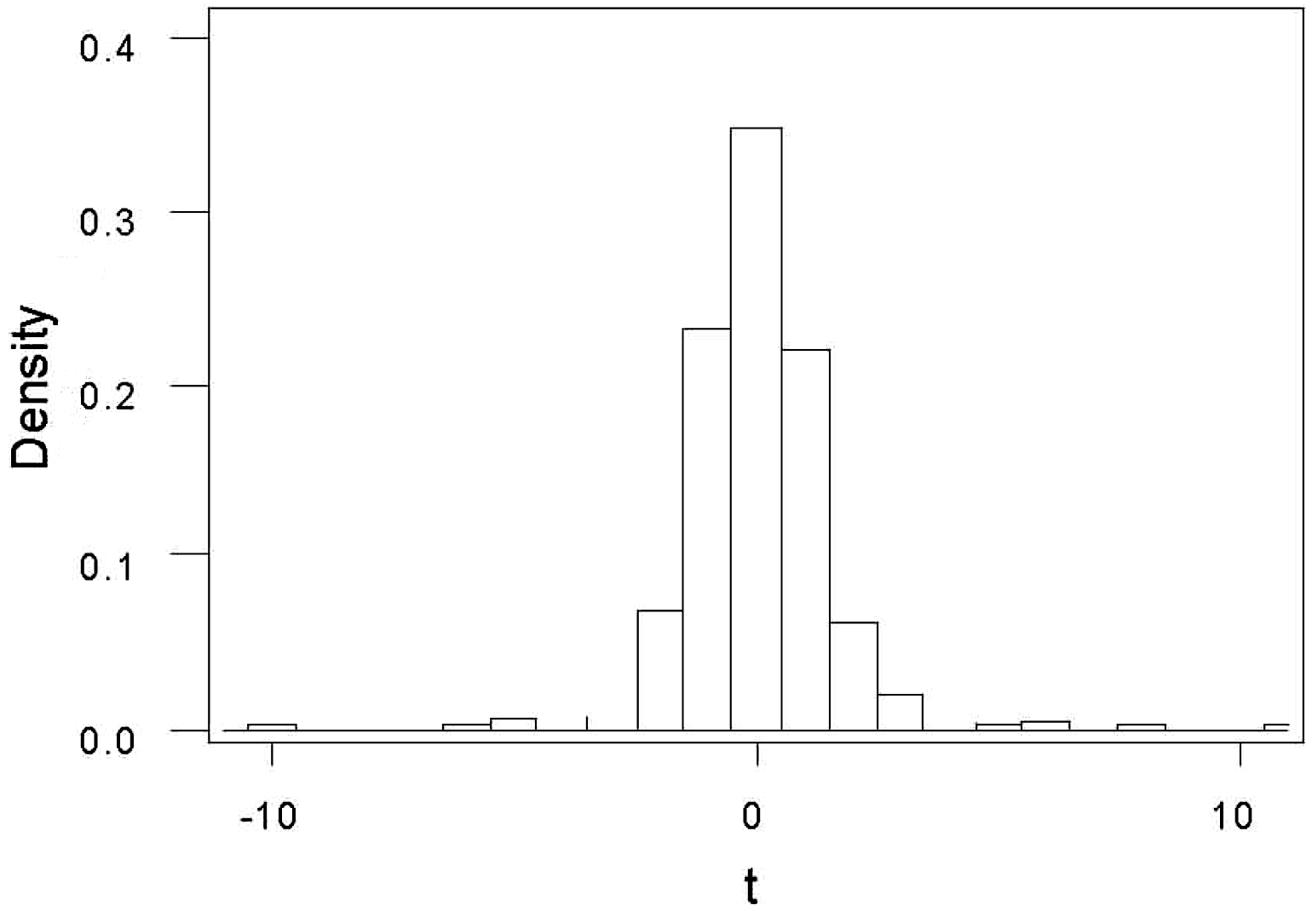
Histogram for t

Slide 19
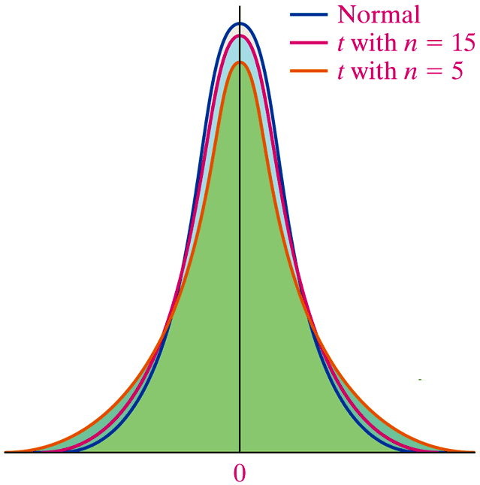

Slide 20
Constructing a (1-α)⋅100% Confidence Interval for μ, σ Unknown
Suppose that a simple random sample of size n is taken from a population with unknown mean μ and unknown standard deviation σ. A (1-α)⋅100% confidence interval for μ is given by
Lower Upper
bound: bound:
Note: The interval is exact when the population is normally distributed. It is approximately correct for nonnormal populations, provided that n is large enough.

Slide 21
Constructing a Confidence Interval about a Population Mean
The pasteurization process reduces the amount of bacteria found in dairy products, such as milk. The following data represent the counts of bacteria in pasteurized milk (in CFU/mL) for a random sample of 12 pasteurized glasses of milk. Data courtesy of Dr. Michael Lee, Professor, Joliet Junior College.
Construct a 95% confidence interval for the bacteria count.

Slide 22
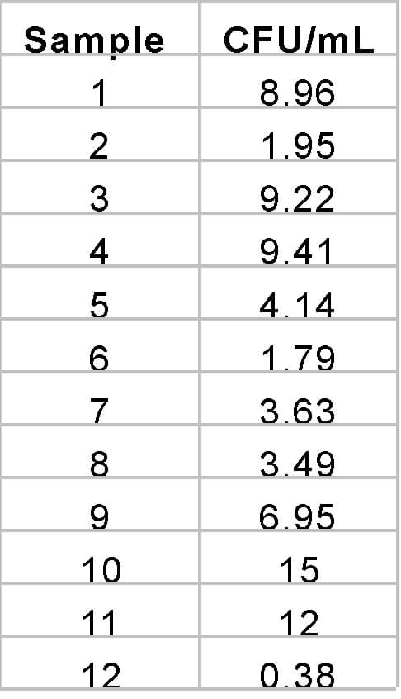
NOTE: Each observation is in tens of thousand. So, 9.06 represents 9.06 x 10⁴.

Slide 23
Lower
bound:
Upper
bound:
The 95% confidence interval for the mean bacteria
count in pasteurized milk is (3.52, 9.30).

Slide 24



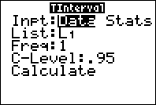
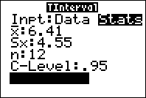
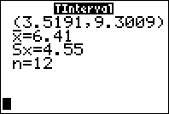

Slide 25
Confidence Intervals for a Population Proportion
A point estimate is an unbiased estimator of the parameter. The point estimate for the population proportion is where x is the number of individuals in the sample with the specified characteristic and n is the sample size.

Slide 26
Sampling Distribution of
For a simple random sample of size n, the sampling distribution of is approximately normal with mean and standard deviation
NOTE: We also require that each trial be independent when sampling from finite populations.

Slide 27
Constructing a Confidence Interval for a Population Proportion
In July of 2008, a Quinnipiac University Poll asked 1783 registered voters nationwide whether they favored or opposed the death penalty for persons convicted of murder. 1123 were in favor.
Obtain a 90% confidence interval for the proportion of registered voters nationwide who are in favor of the death penalty for persons convicted of murder.

Slide 28
Solution
α=0.10 so z_{α/2}=z_{0.05}=1.645
Lower bound:
Upper bound:

Slide 29


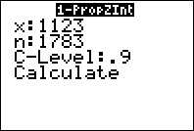
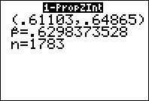

Slide 30
Sample size needed for a specified margin of error, E, and level of confidence (1-α):
Problem: The formula uses which depends on n, the quantity we are trying to determine!

Slide 31
A sociologist wanted to determine the percentage of residents of America that only speak English at home. What size sample should be obtained if she wishes her estimate to be within 3 percentage points with 90% confidence assuming she uses the 2000 estimate obtained from the Census 2000 Supplementary Survey of 82.4%?

Slide 32
Solution
E=0.03
We round this value up to 437. The sociologist must survey 437 randomly selected American residents.

